Slide 1

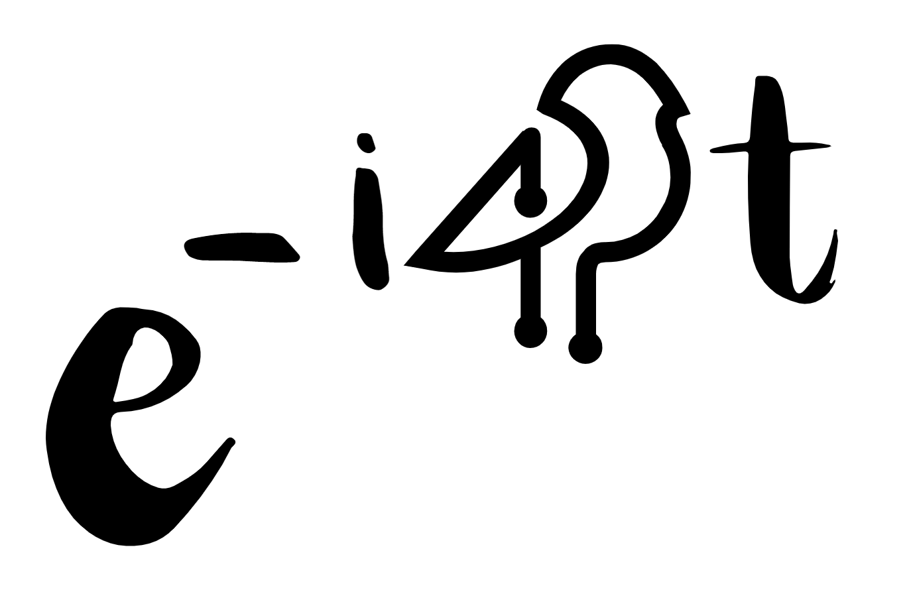
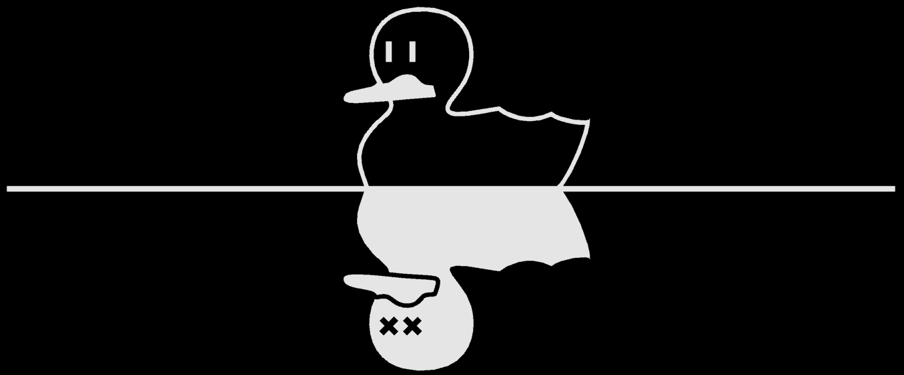

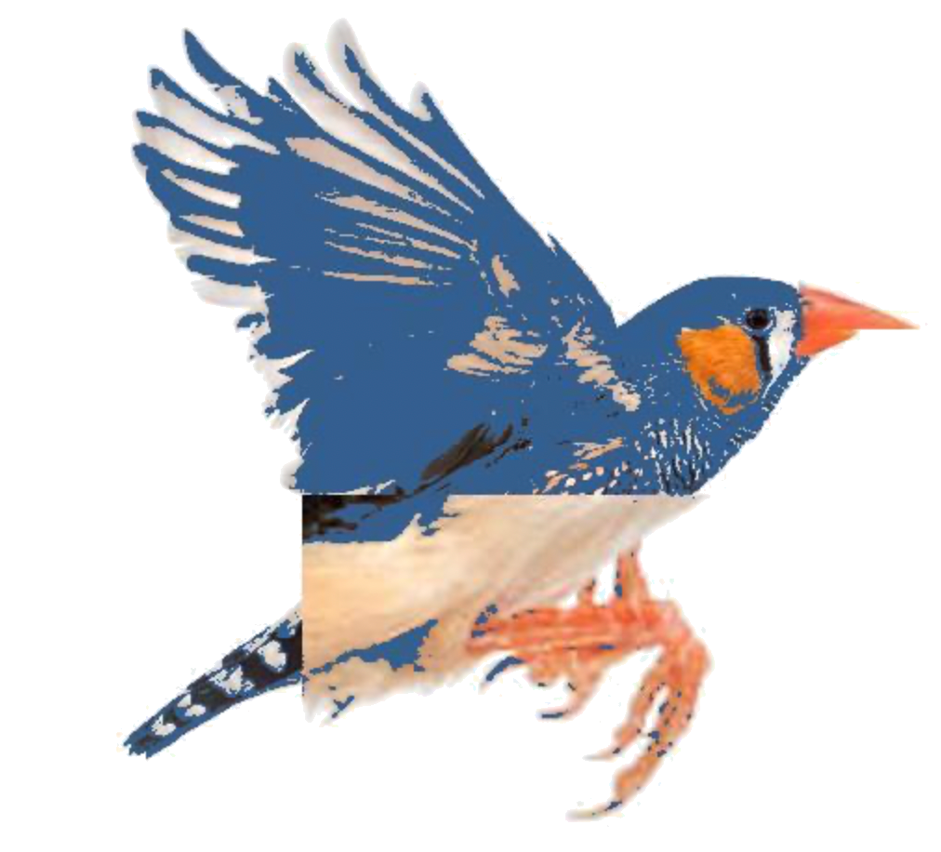
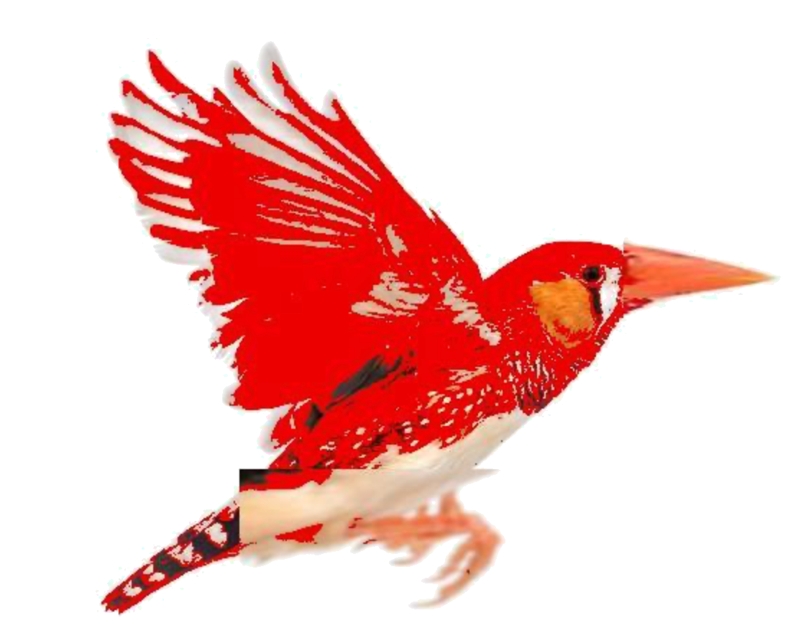

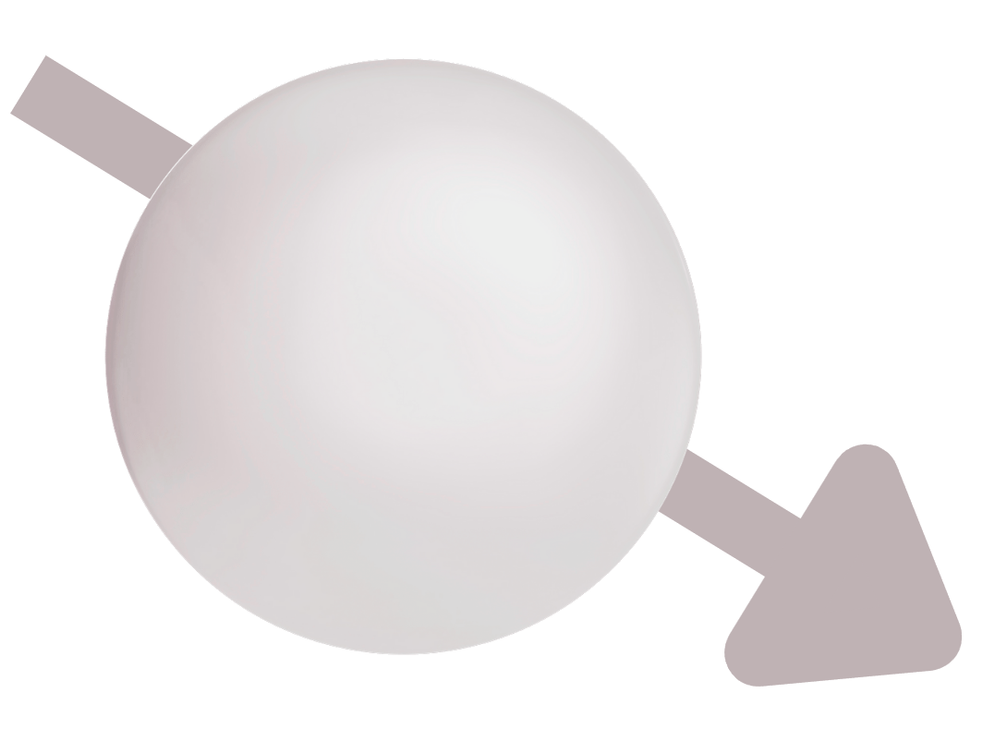
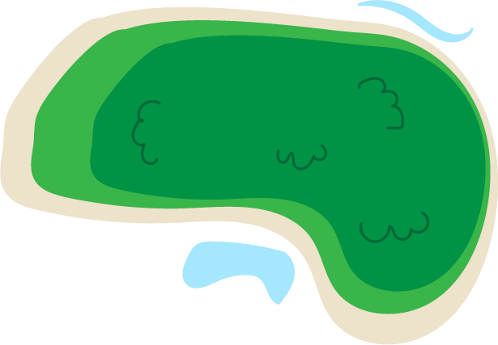
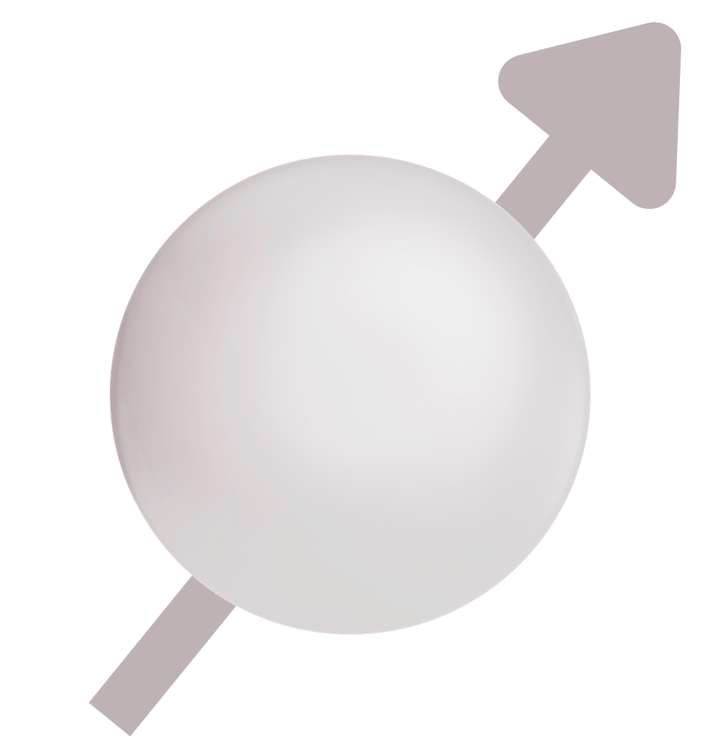

Game of Finches
Beagle
Interactive modelling of biological evolution
on a trapped ion quantum computer

Slide 2
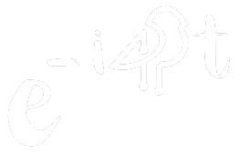
Our project
Task: "Create something new"
Solution: Interactive model of biological evolution
Analogy between probabilistic natures of quantum measurement and biological evolution
Numerical outcomes are very dry... visualization is key!
Summary
Evolutionary model and visualization
Quantum circuit implementation
Example simulations
Demo

Slide 3
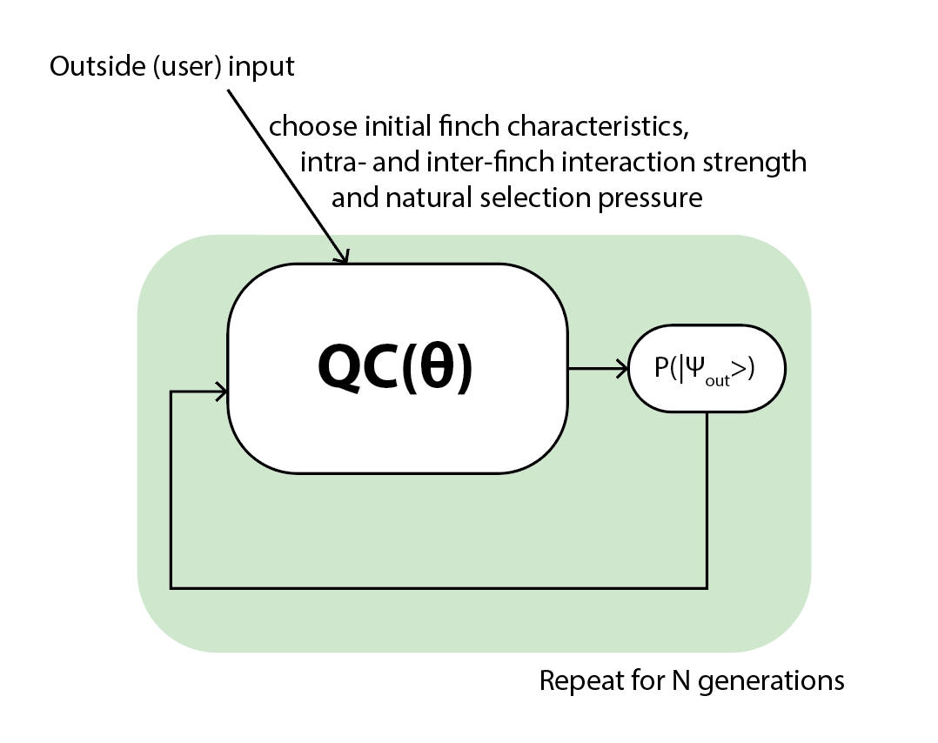
The approach
Unitary quantum circuits cannot evolve towards a preferred outcome, but measurements add a dissipative force that can “push” towards a state
Entangling gates scramble qubits
Competition of these effects allow for interesting dynamics to simulate evolution

Slide 4
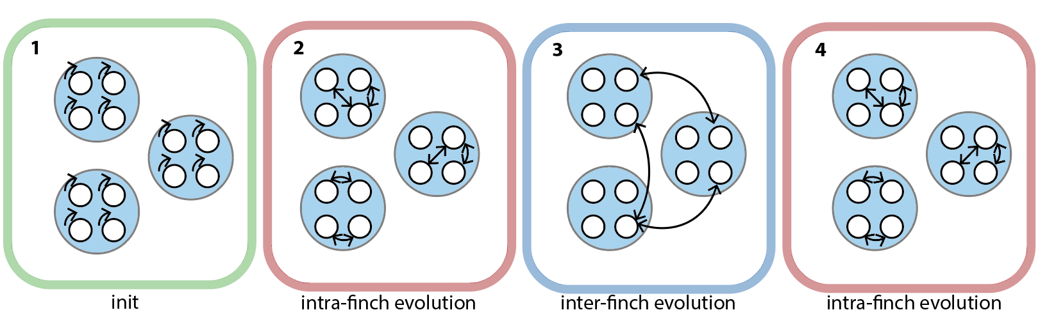
The quantum circuit

Slide 5
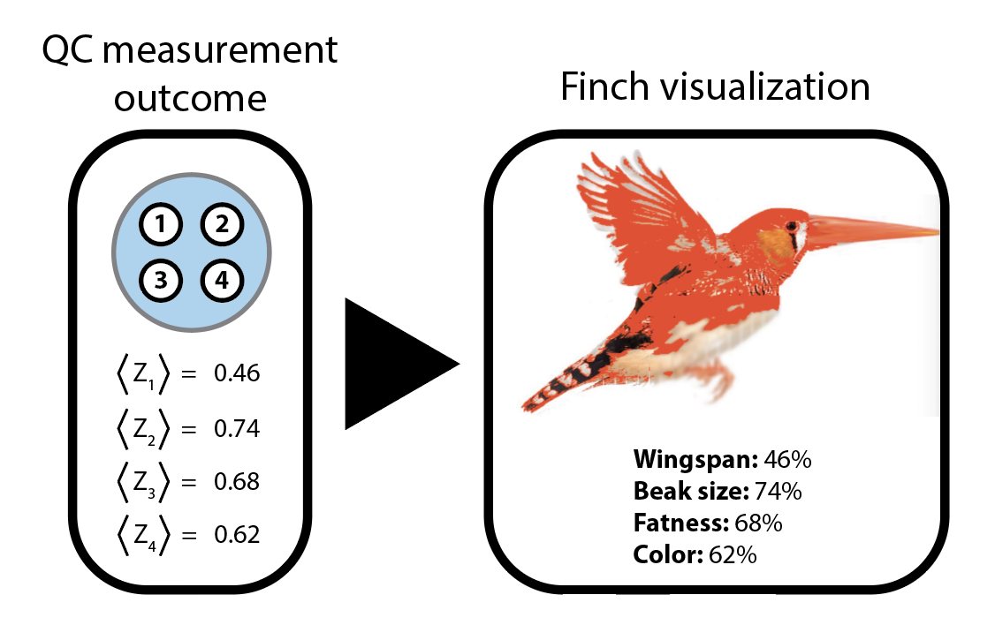
Finch encoding and visualization
Each characteristic can take on any value between 0 and 1

Slide 6
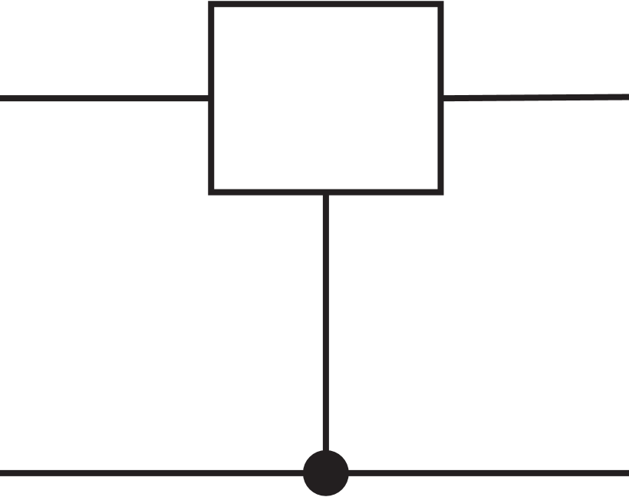
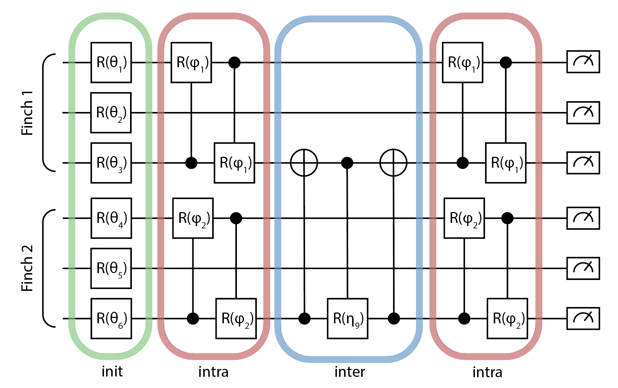
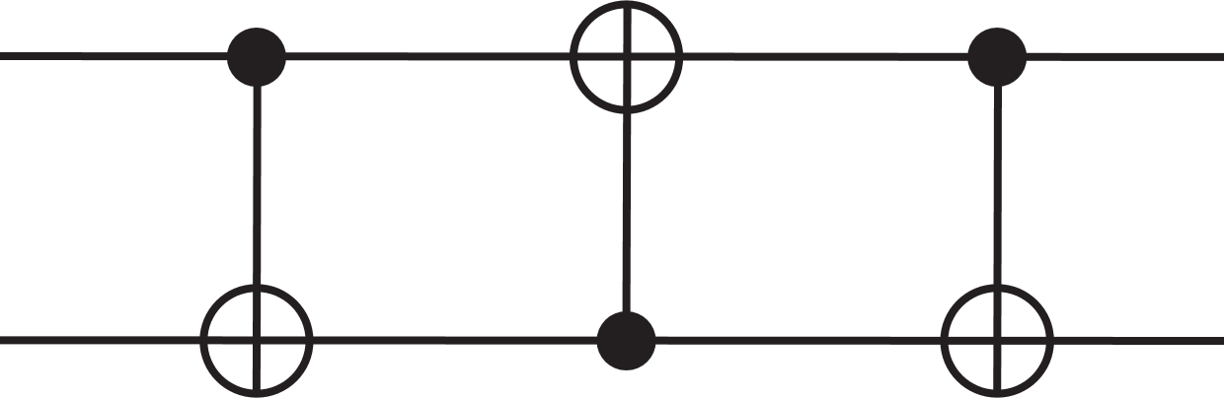

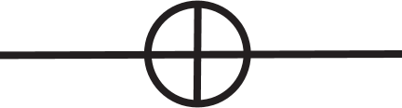
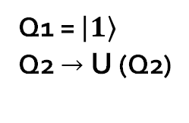
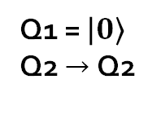
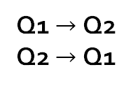
Recap: QC diagrams
Single qubit X rotation
Control
Q1
SWAP
Measurement
(Z basis)
Q1
Q2
U
Q2
X (bit flip)
Q1 $→$ Q2 Q2 $→$ Q1
Q1 = $\left|0\right\rangle$
Q2 $→$ Q2
Q1 = $\left|1\right\rangle$
Q2 $→$ U (Q2)

Slide 7
The quantum circuit
Init: rotations angles are set by a combination of the previous QC outcome and natural selection pressure
Intra: CR gates build correlations between characteristics of individual finches
Inter: partial SWAP gates model exchange of characteristics between finches

Slide 8
Finch visualization
Control wingspans
1. Separate image into our 4 finch characteristics (wingspan, beak size, fatness, colour)
2. Benchmark the scaling factor of each characteristic:
scaling factor = QC output x benchmark value
Control beak size
Control fatness

Slide 9
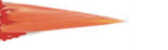
Finch visualization
Wingspan and beak size: Capture the wings/beak and scale
Fatness: Distort pixel positions in the bird’s breast to change fatness
Color: Change color according to color map
Each denotes a pixel and the line denotes the edge of the bird’s breast (‘fatness control area’)

Slide 10
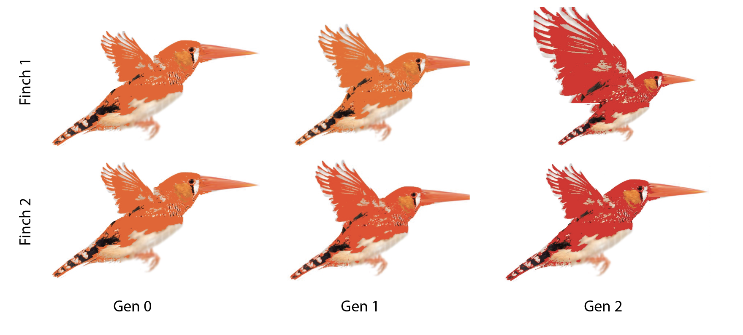
Finch evolution on Harmony

Slide 11
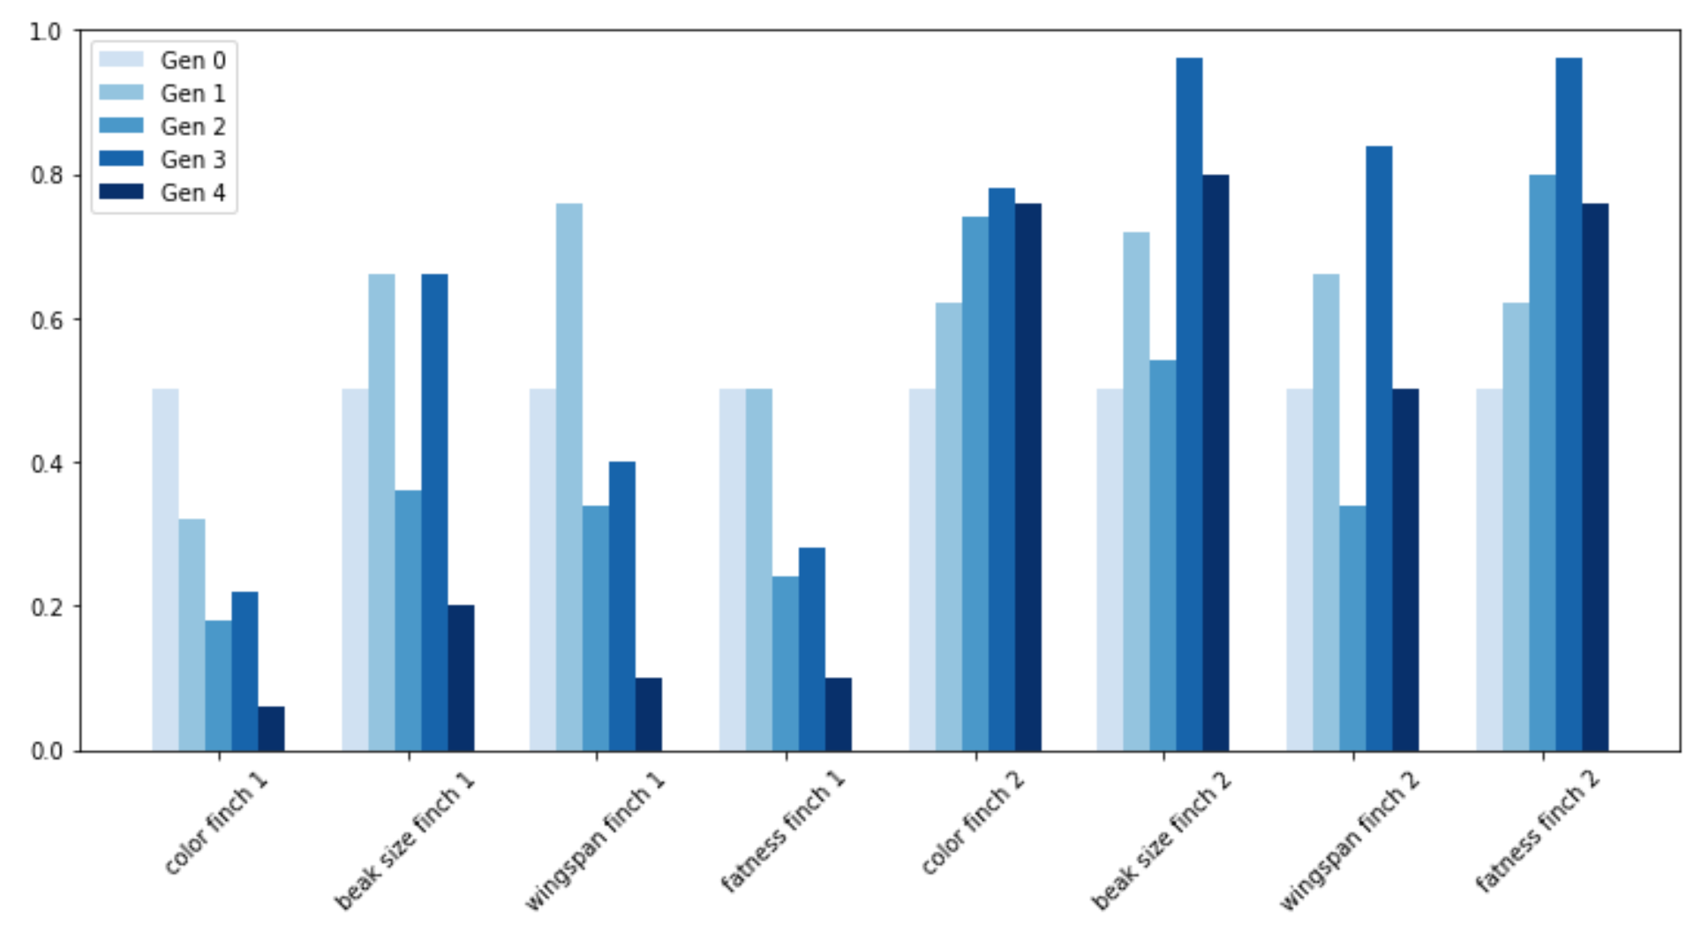
Typical evolution result
Start all characteristics at 0.5, natural selection pushes finch 1 characteristics to 0 and finch 2 characteristics to 1, with weak interaction

Slide 12
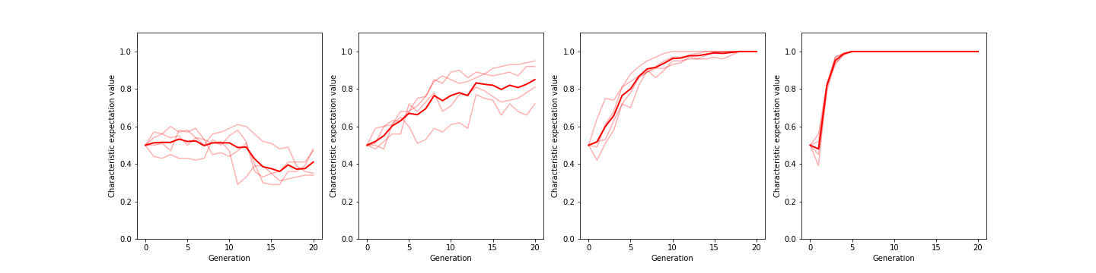
Natural selection bias
Vary natural selection pressure (towards 1)
Strength = 0
Strength= 0.05
Strength= 0.1
Strength= 0.4

Slide 13
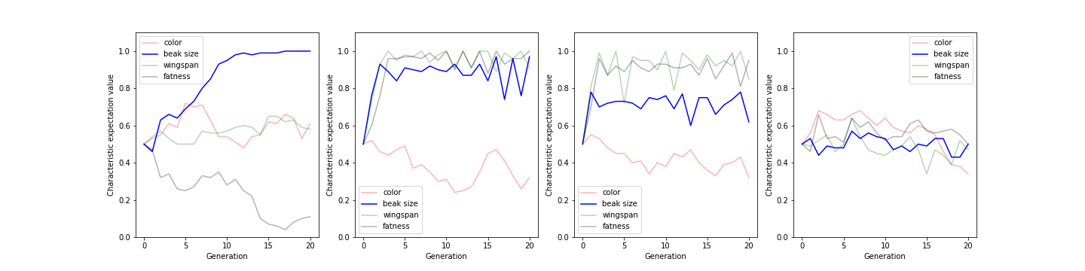
Intra-finch evolution
Vary intra-finch interactions
color
Beak size
Natural selection pressure (towards 1)
wingspan
fatness
Int. angle = 0
Int. angle = π/5
Int. angle = π/3
Int. angle = π

Slide 14
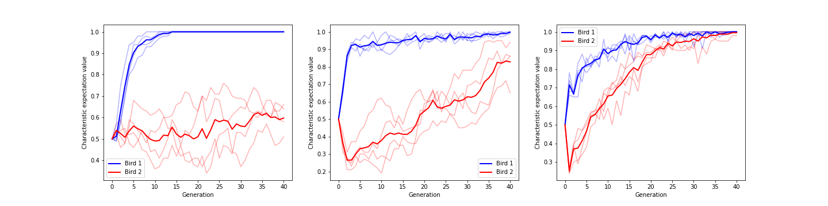
Inter-finch mixing
Natural selection pressure (towards 1)
no natural selection
vary interaction
Bird 1
Bird 2
Swap angle = 0
Swap angle = π/4
Swap angle = π/2

Slide 15
Finch evolution
Complex, multi-layered quantum circuit explores and visualizes finch evolution, with interplay of correlations, randomness, and natural selection
Intra- and inter-finch interactions harness the all-to-all connectivity of the IonQ platform
Dephasing and pulse errors are not necessarily an issue, add an extra layer of randomness to the evolution

Slide 16
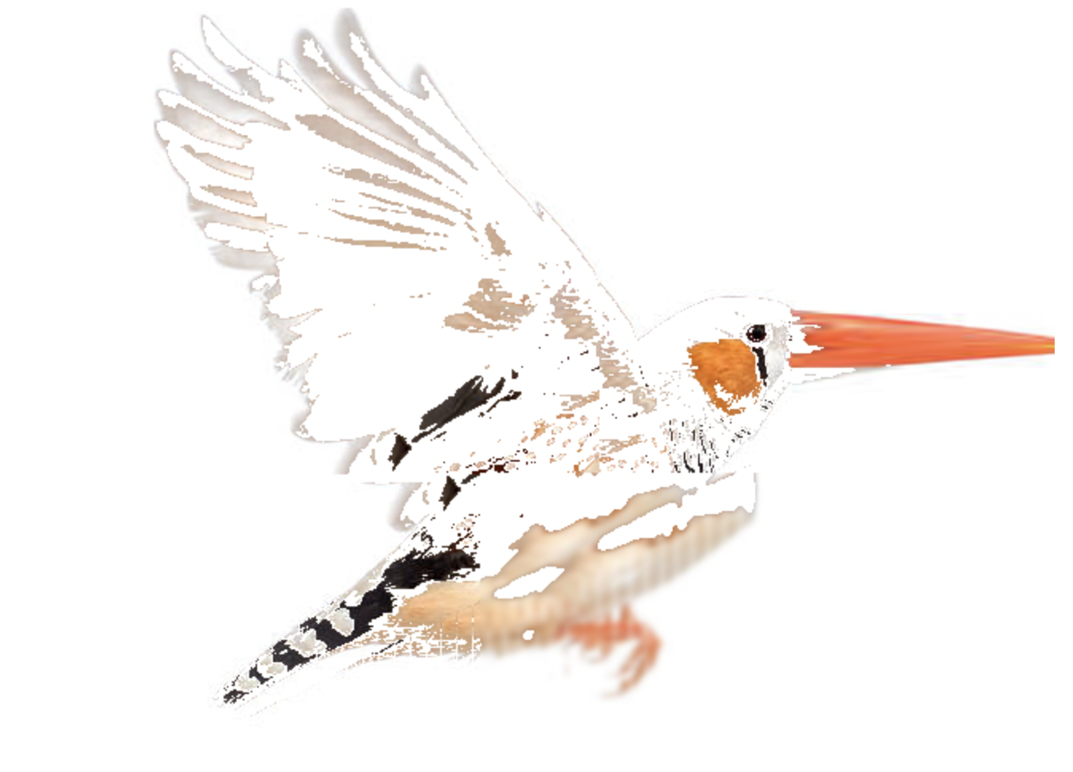
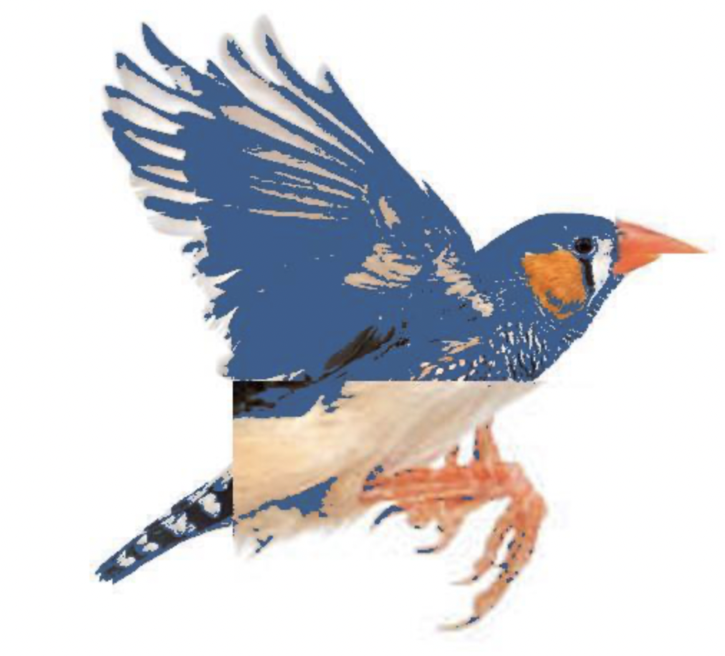
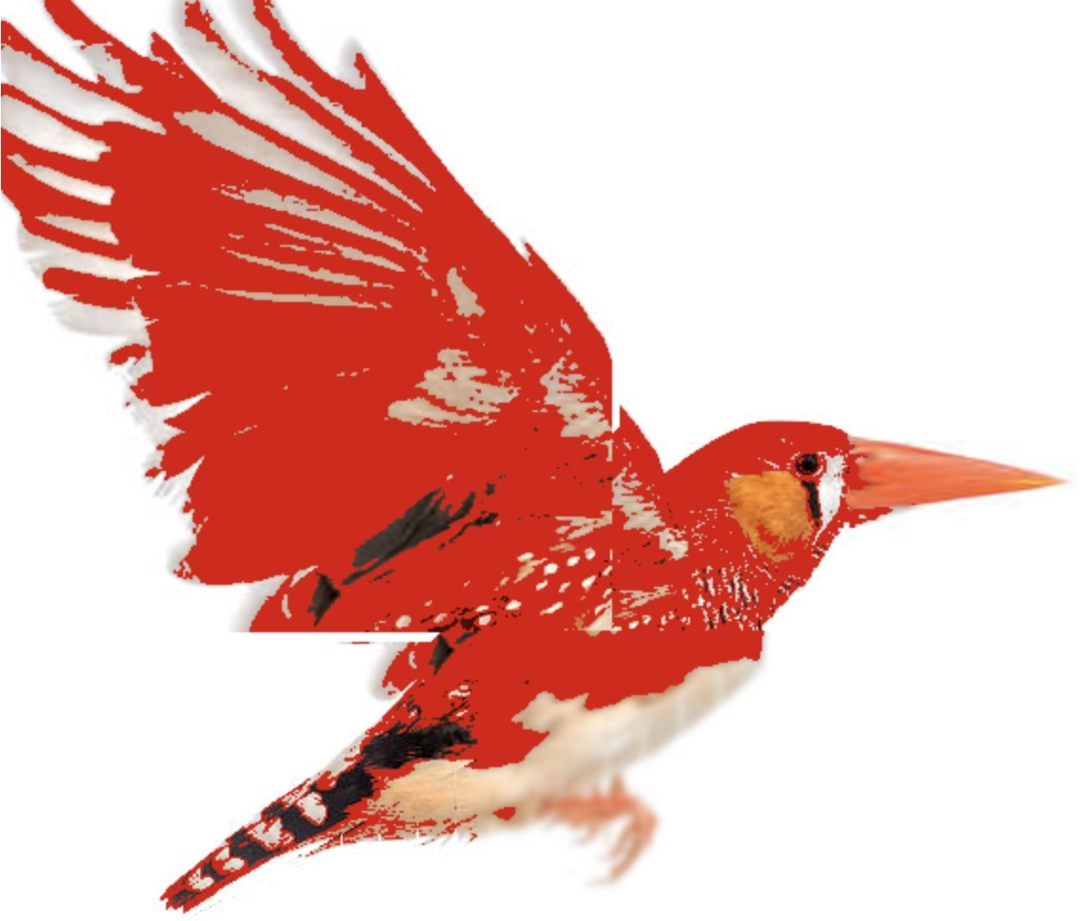
Finch Hall of Fame

Slide 17
Links
Github: https://github.com/ZixiaoXu/2023_IonQ
Blog post: https://finchesentangled5.wordpress.com

